Slide 1


Tele-Rehabilitation: Digital Solutions for Enhanced Recovery
By
Moinak Niyogi(22BCS10944)
Prince Sarker(21BPT1142)

Slide 2
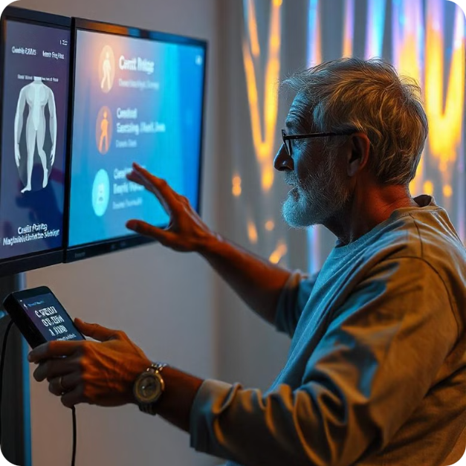
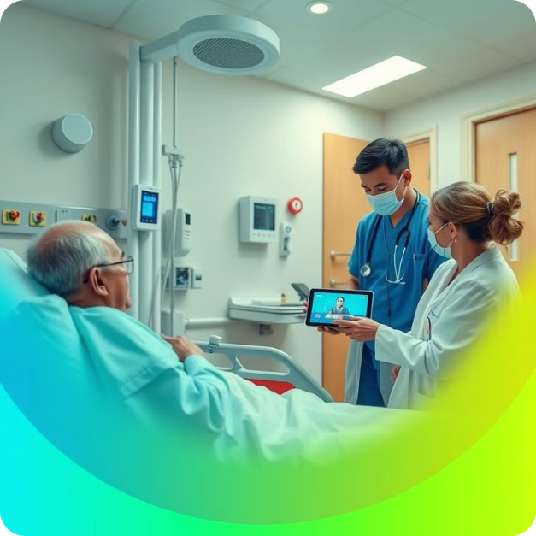
Our Mission: Bridging the Gap Between Traditional and Modern Rehabilitation
Tech-Driven Innovation
Bridging the Gap
Enhancing recovery through innovative digital solutions.
Connecting traditional rehabilitation with modern technology via user-friendly apps and websites for various healthcare settings.
ggggggggghhgggnnnnnnnnnnnnnn
ggggggggghhggg

Slide 3
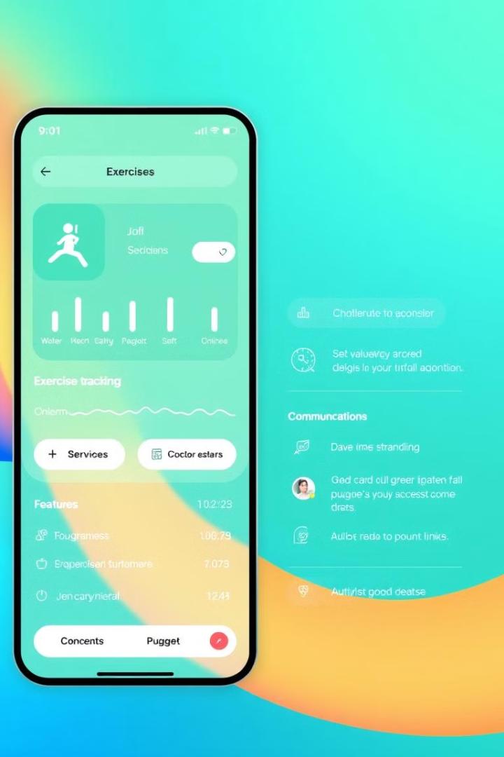
Key Features of Our Tech-Driven Platform
1
Personalized Exercise Plans
2
Real-Time Progress Tracking
Tailored to individual patient needs and goals.
Monitor recovery progress and adjust treatment plans accordingly.
3
Secure Communication Tools
4
Data-Driven Insights
Providing valuable data for optimizing patient care.
Facilitating seamless communication between patients, therapists, and caregivers.

Slide 4

Improving Patient Outcomes Through Innovative Digital Tools
Enhanced Patient Engagement
Increased Adherence to Treatment
Motivational tools and interactive features.
Improved patient engagement leads to better compliance.
Reduced Hospital Readmissions
Improved Quality of Life
Improved patient outcomes through proactive interventions.
Empowering patients to take control of their recovery journey.
ggggggggghhgggnnnnnnnnnnnnnn
ggggggggghhggg

Slide 5





Enhancing the Patient Experience with User-Friendly Design
Intuitive Interface
Personalized Schedules
Secure Communication
Interactive Tutorials
Easy to use and navigate, accessible to all.
Tailored to individual needs and preferences.
Seamless communication with healthcare providers.
Demonstrating exercises and proper techniques.
ggggggggghhgggnnnnnnnnnnnnnn
ggggggggghggggghhggg

Slide 6
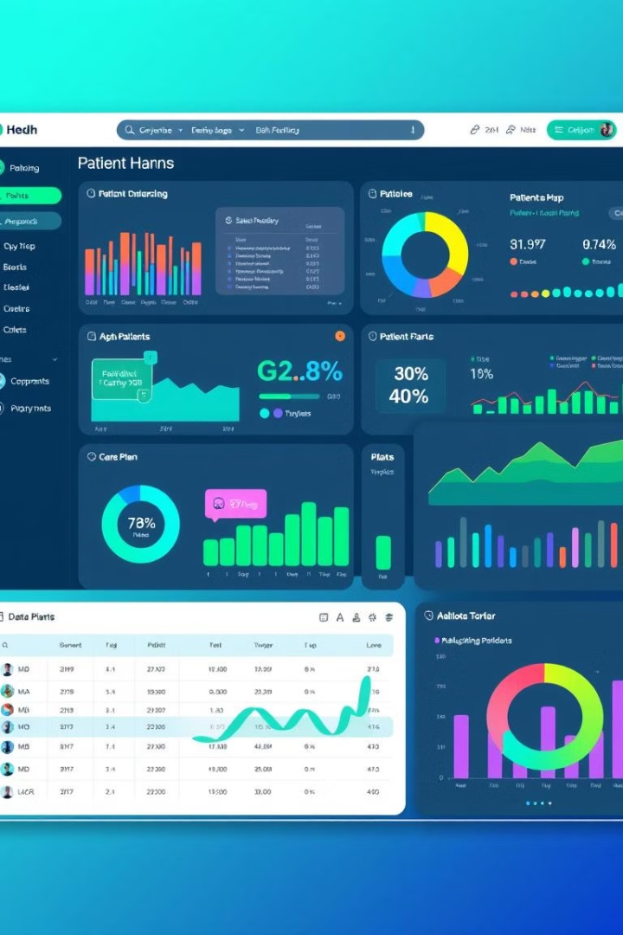
Empowering Healthcare Providers with Data-Driven Insights
1
Real-Time Data
Monitor patient progress and adjust treatment plans accordingly.
2
Personalized Reports
Provide a comprehensive overview of each patient's recovery journey.
3
Data-Driven Decision-Making
Optimize care and improve patient outcomes.
ggggggggghhgggnnnnnnnnnnnnnn
ggbnbbbnn bbbnbbnnmmkkkggggggghhggg

Slide 7
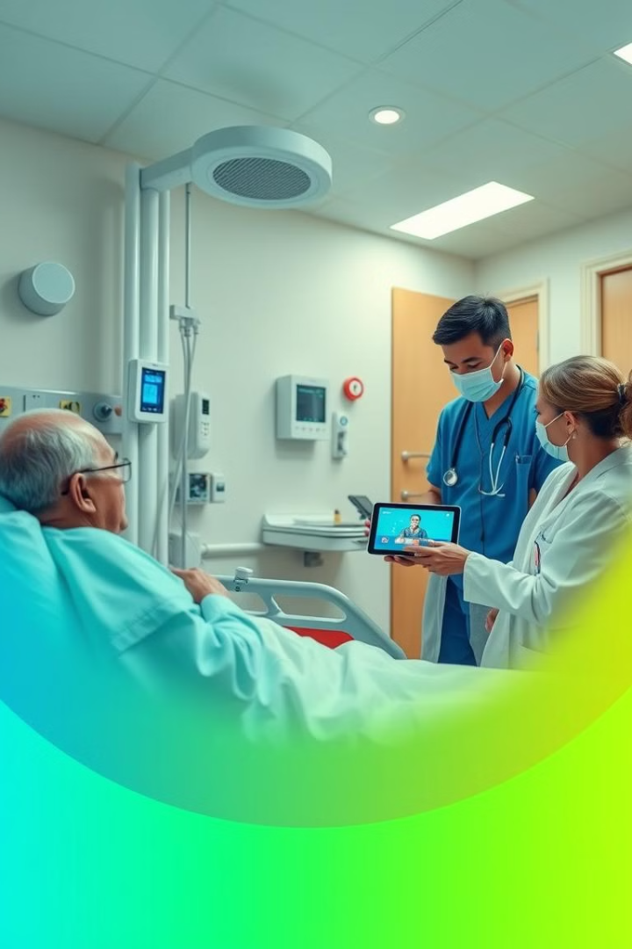



Target Audience
Hospitals
Streamline care, enhance patient engagement, and reduce readmissions.
Nursing Homes
Personalized care plans, improve resident well-being, and promote independence.
Rehabilitation Centres
Remotely deliver personalized treatment plans and monitor patient progress.

Slide 8

The Road Ahead: Driving the Next Generation of Rehabilitation
We are committed to driving the next generation of rehabilitation through technology. Our vision is to make rehabilitation accessible, affordable, and effective for everyone.
ggggggggghhgggnnnnnnnnnnnnnn

